Slide 1
Supplementary information –
Papineau et al. (2018)
Fossil biomass preserved as graphitic carbon in a late Paleoproterozoic banded iron formation metamorphosed at more than 550ºC
Dominic Papineau^{1,2,3}, Bradley T. De Gregorio⁴, James Sagar¹, Richard Thorogate¹, Jianhua Wang⁵, Larry Nittler⁵, David D.A. Kilcoyne⁶, Hubertus Marbach⁷, Martin Drost⁷, Geoff Thornton^{1,8}
1 London Centre for Nanotechnology, 17-19 Gordon Street, University College London, London, U.K.
2 Department of Earth Sciences, University College London, London, U.K.
3 Centre for Planetary Sciences, UCL/Birkbeck, London, U.K.
4 Materials Science and Technology Division, U.S. Naval Research Laboratory, Washington DC, U.S.A.
5 Department of Terrestrial Magnetism, Carnegie Institution for Science, Washington, DC, U.S.A.
6 Advanced Light Source, Lawrence Berkeley National Laboratory, Berkeley, CA, U.S.A.
7 Microscopy and Nanolithography Group, Lehrstuhl Für Physikalische Chemie II, Friedrich-Alexander-Universität Erlangen-Nürnberg, Erlangen, Germany.
8 Department of Chemistry, University College London, 20 Gordon Street, London, London U.K.
Content
Figures S1-S5

Slide 2
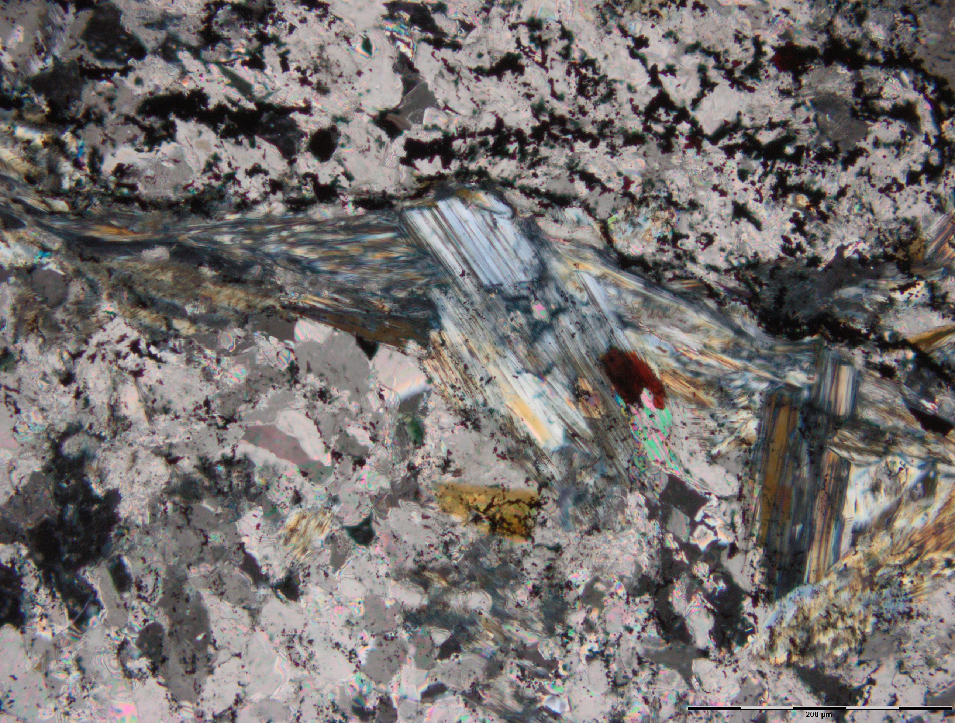
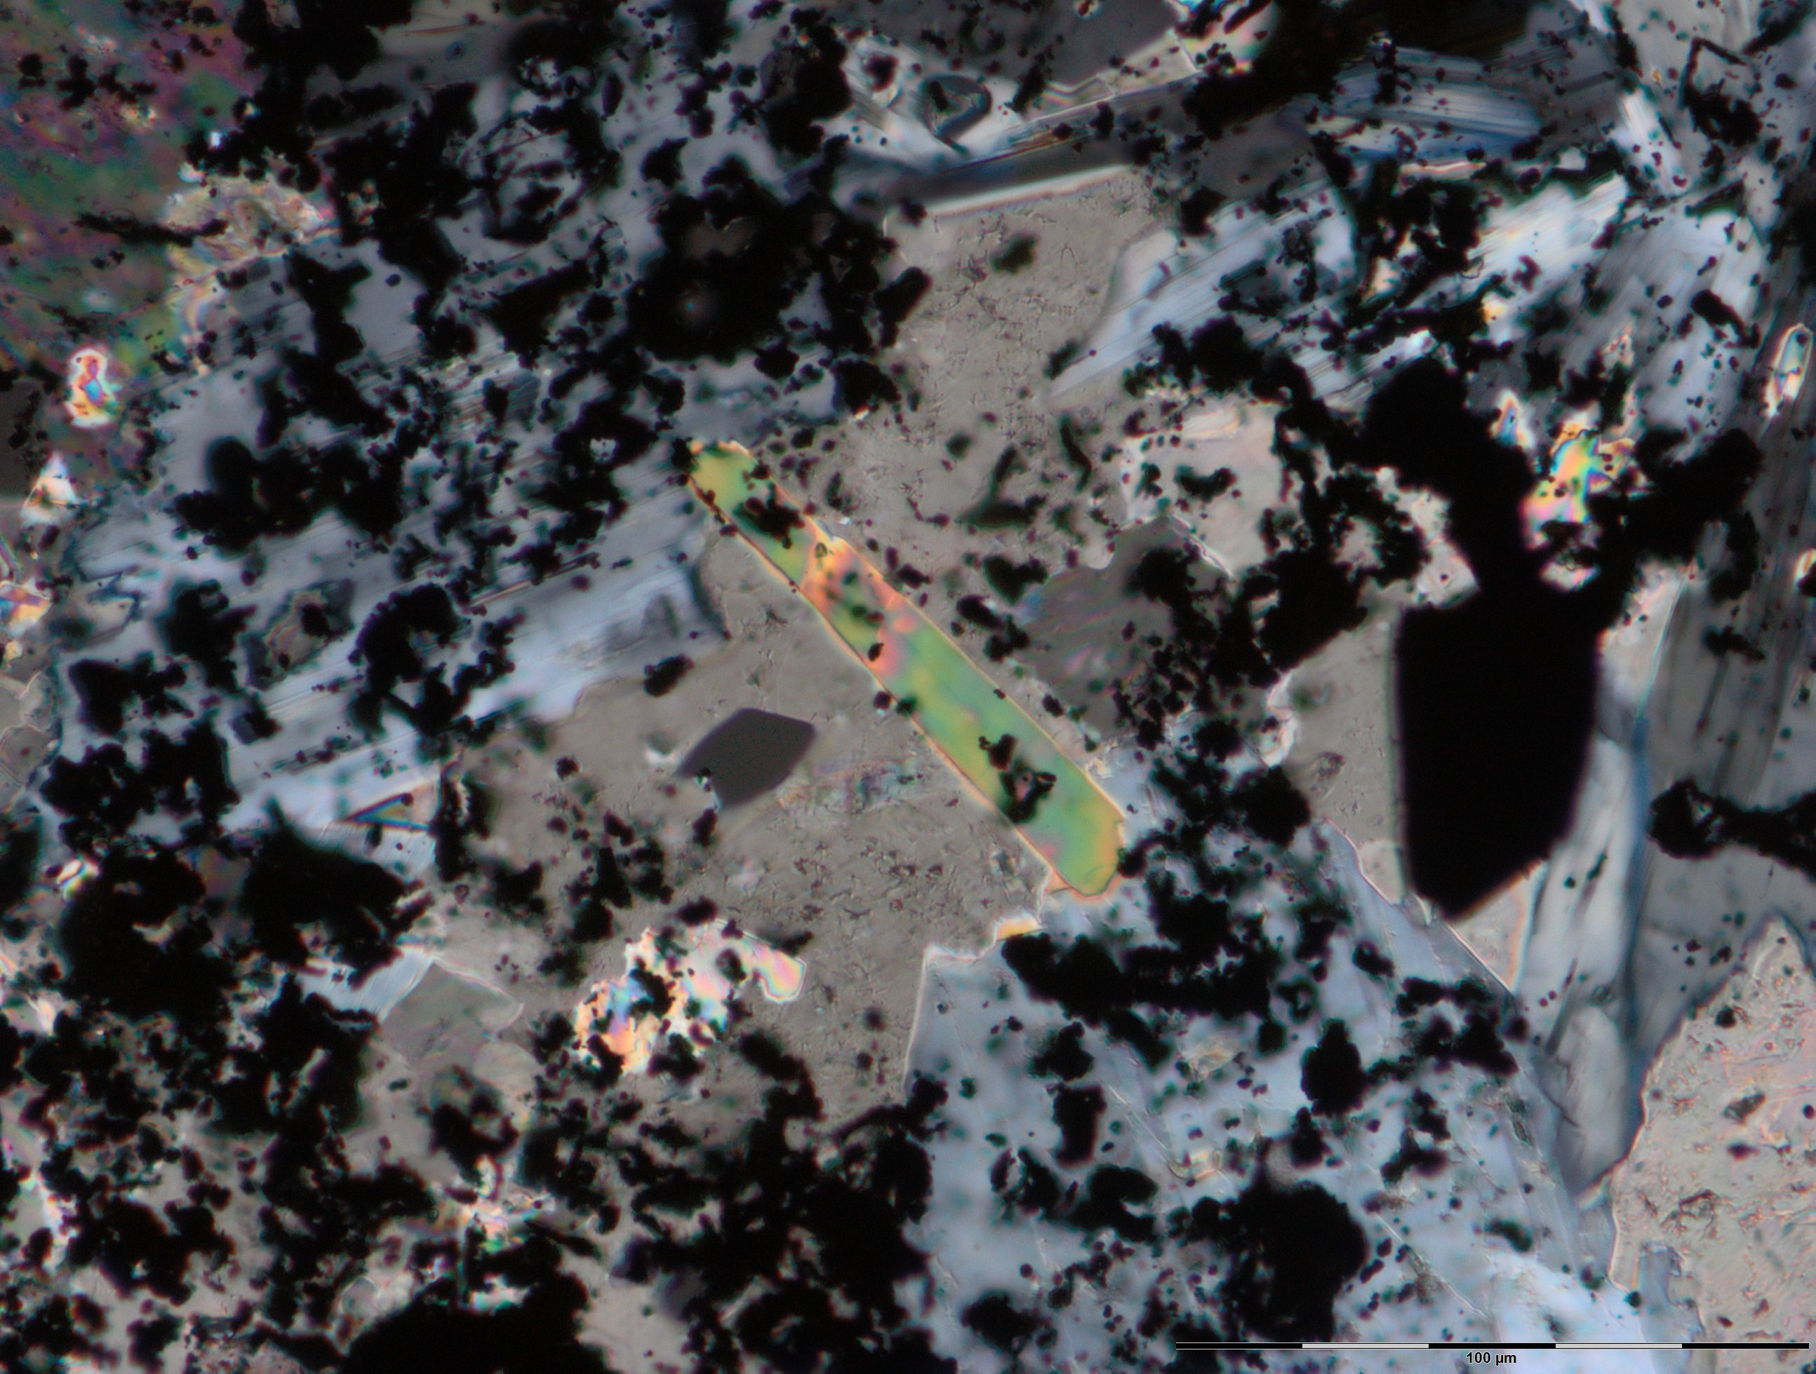
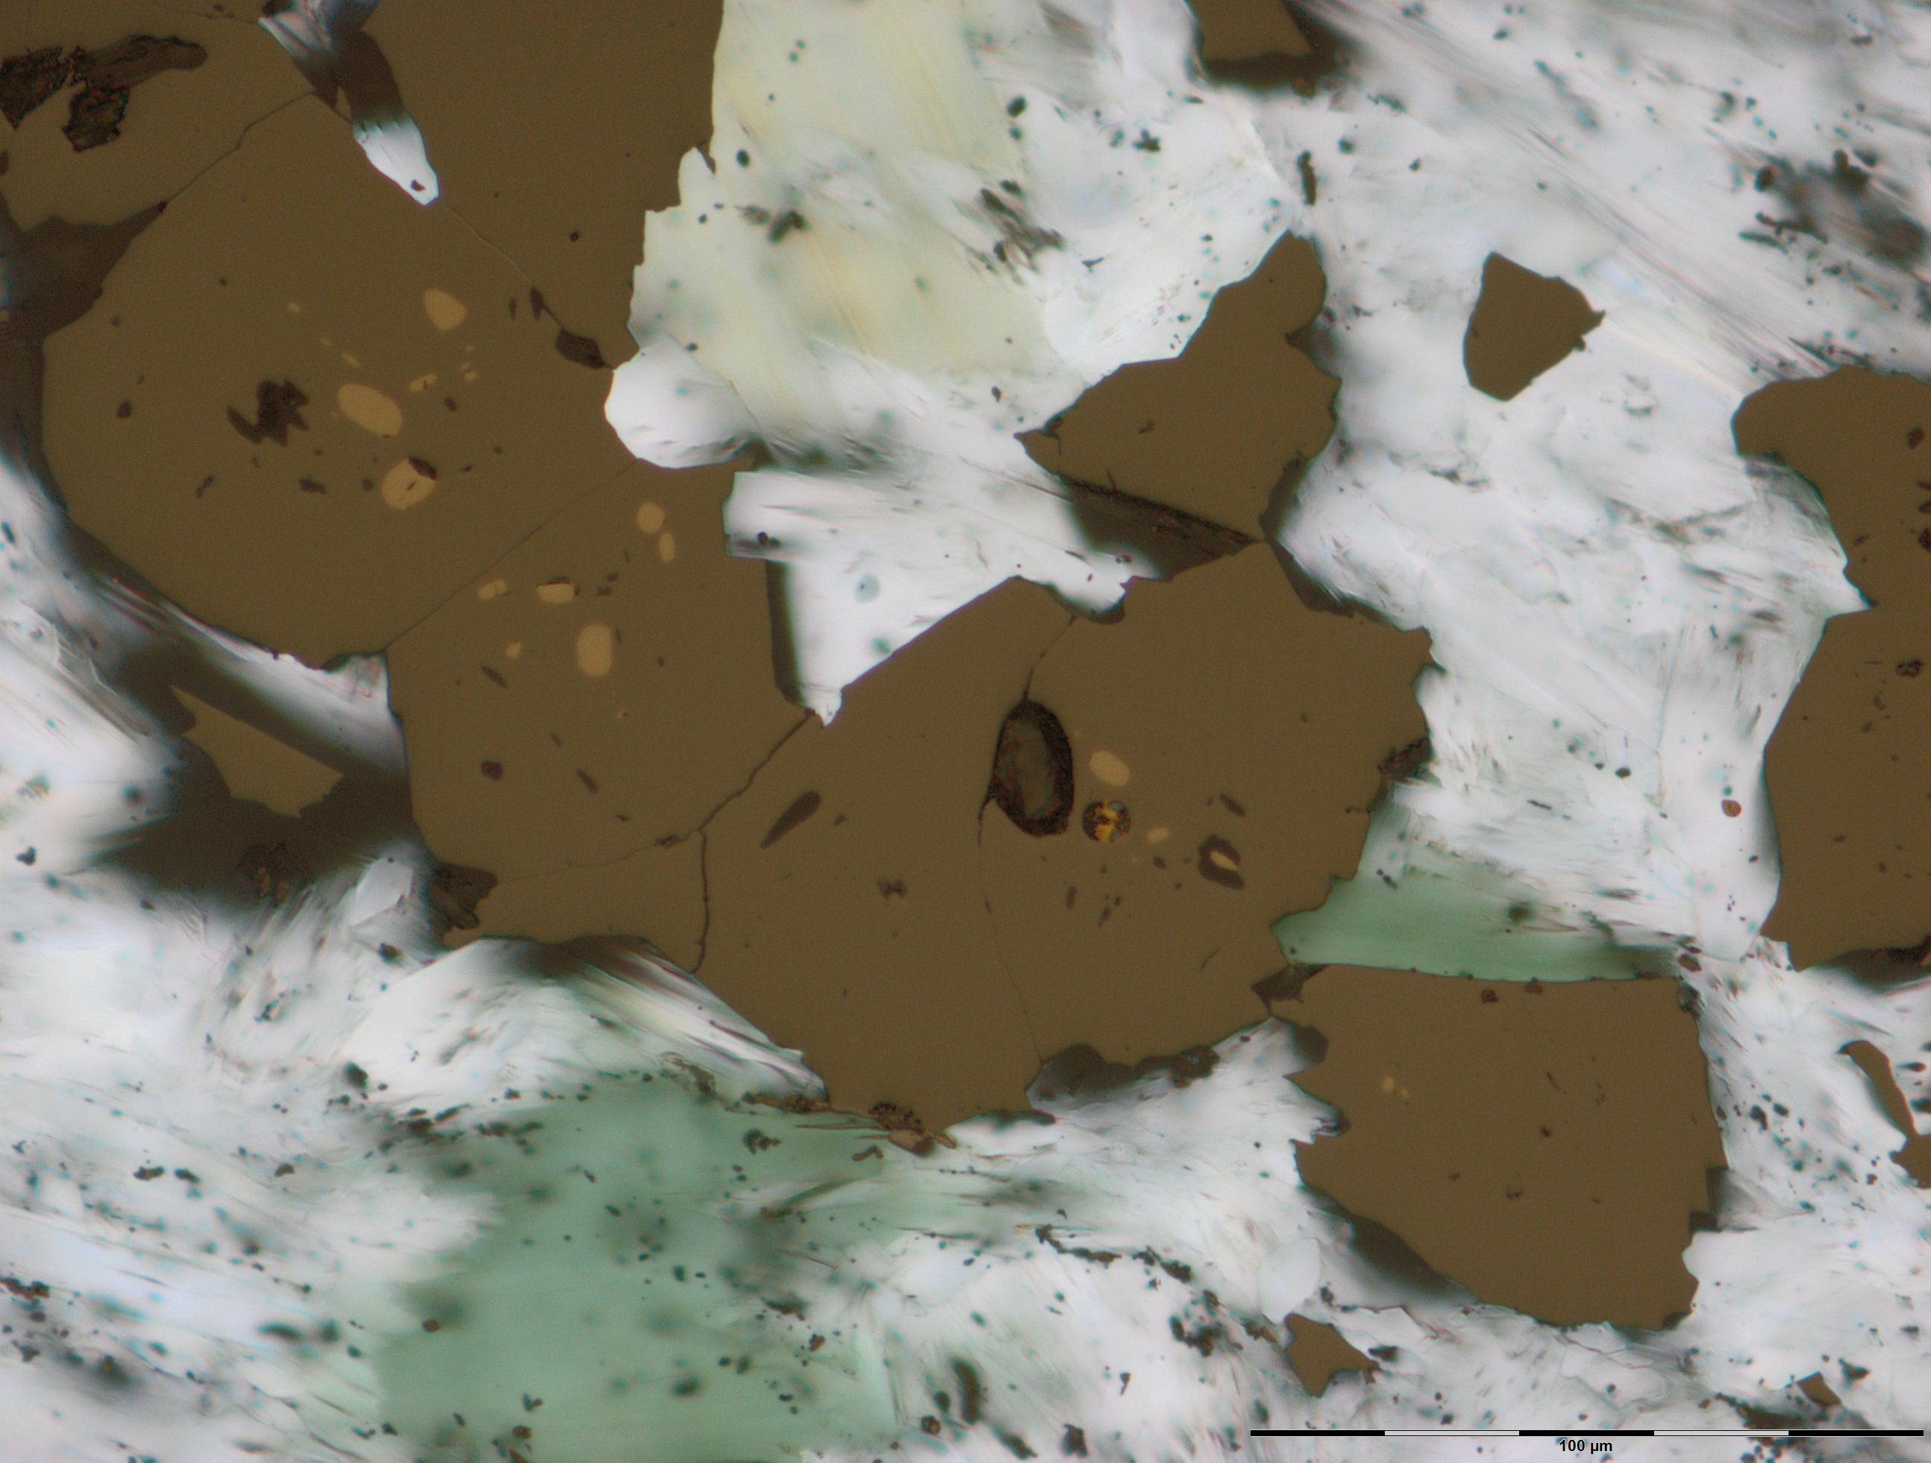
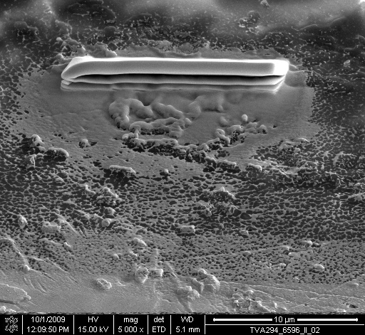
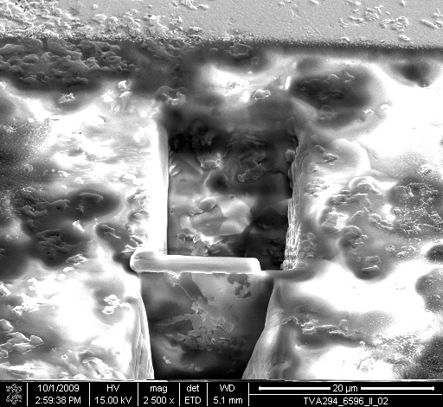
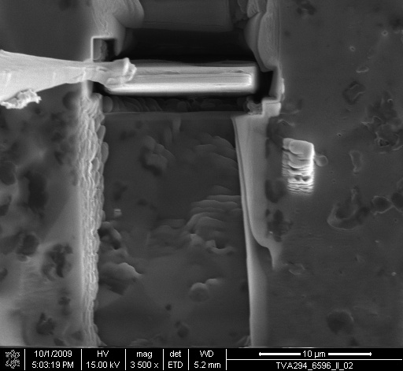
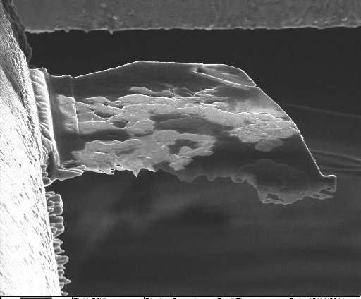
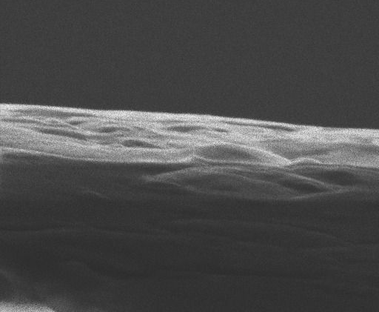
Figure S1 – Papineau et al. (2018)
a)
CP
b)
CP
c)
TL
gra
gru
bio
po
mag
dol
20 μm
dol
20 μm
20 μm
chl
d)
SE
e)
SE
f)
SE
Pt shield
5 μm
10 μm
SE
10 μm
g)
SE-He
h)
SE-He
i)
SE-He
f)
2.5 μm
2 μm
200 nm
Figure S1: Additional petrographic context showing (a-c) petrographic context of silicate and Mn-dolomite bands in Michigamme BIF showing prograde grunerite and biotite, and retrograde chlorite. Micrometre-size pyrrhotite spheroidal grains occur in magnetite. (d-i) Secondary electron image of the target during in situ nano-fabrication: (d) site of the Pt shield deposition, (e) exposed lamella, f) W needle welded with Pt before lift-out, g) Lamella welded with Pt onto Cu TEM half grid, (h-i) after TEM, STXM, and NanoSIMS analyses, the FIB lamella was milled further using a focused Ne beam, and i) high-resolution titled view of the lamella prior to atomic force microscopy and local Auger electron spectroscopy.

Slide 3
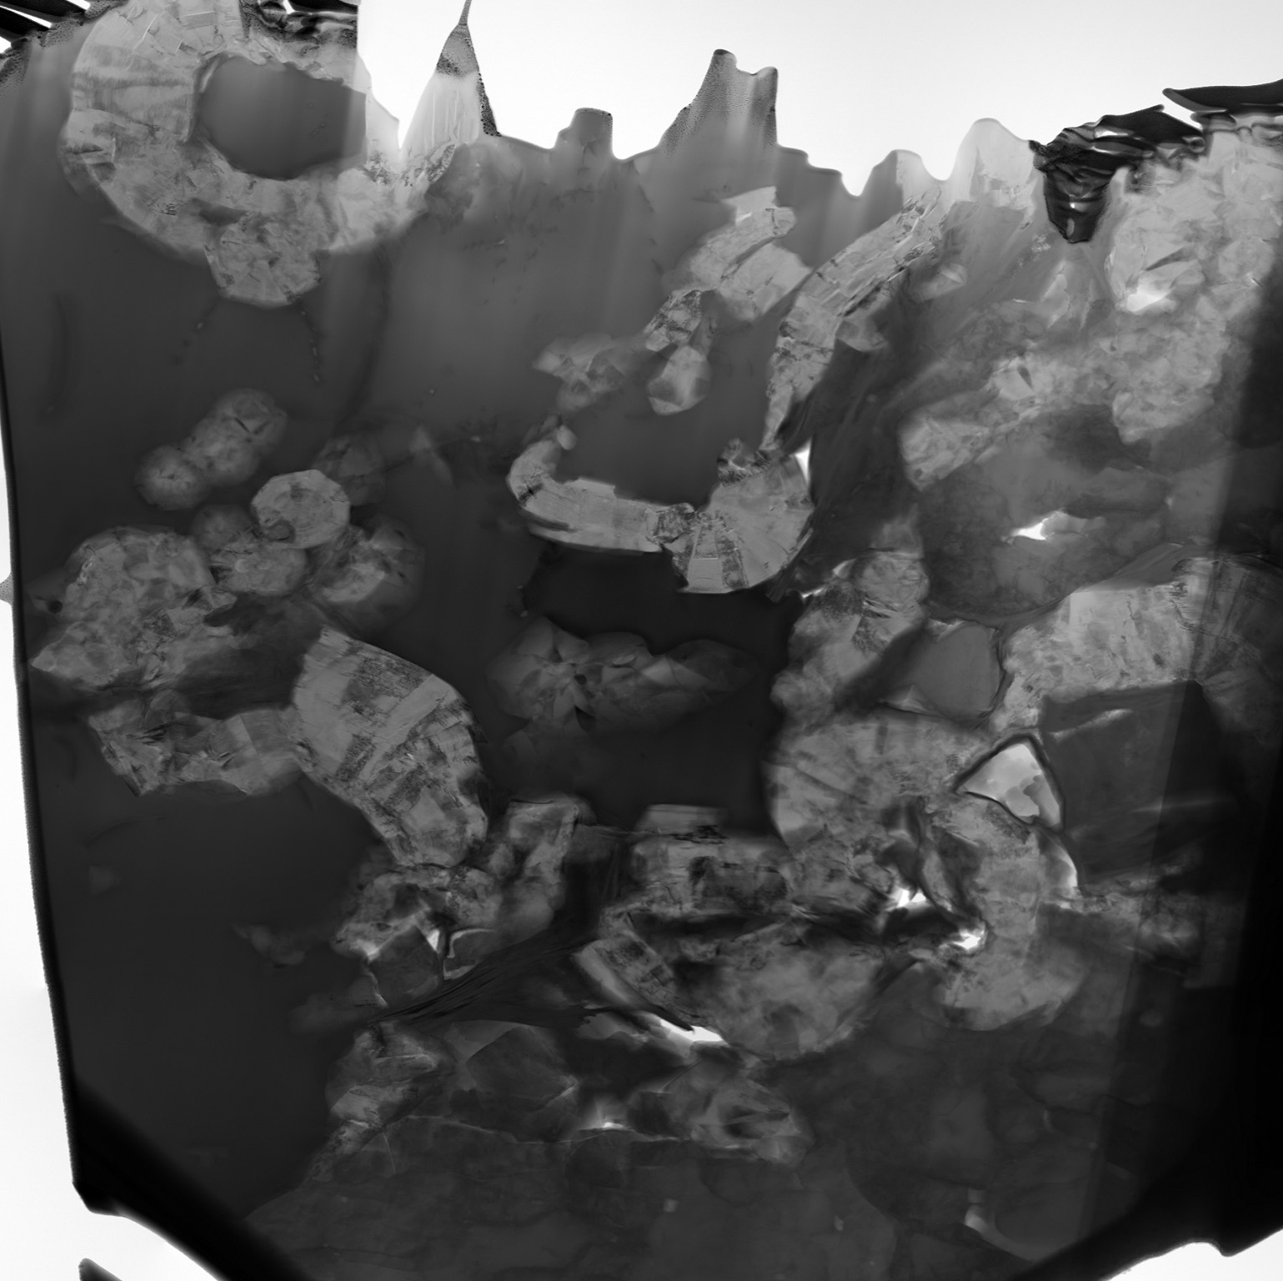
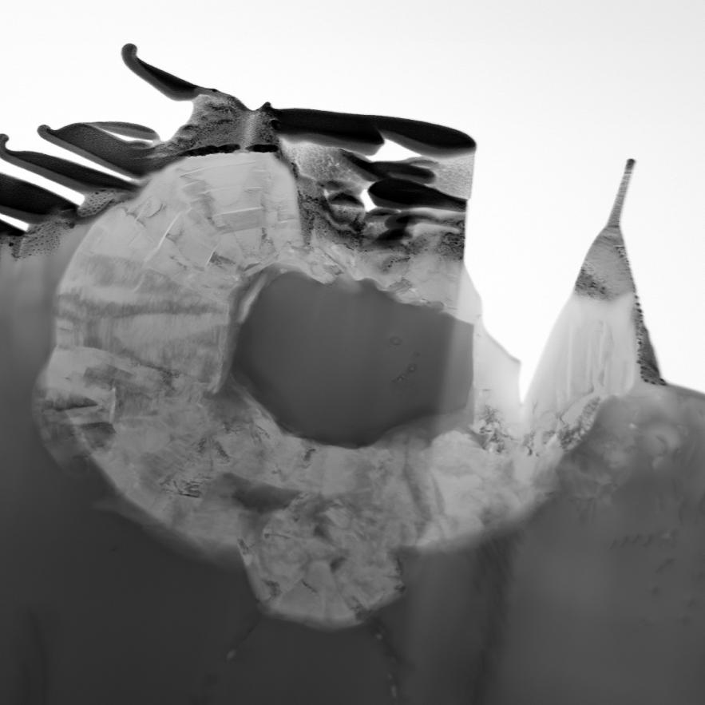
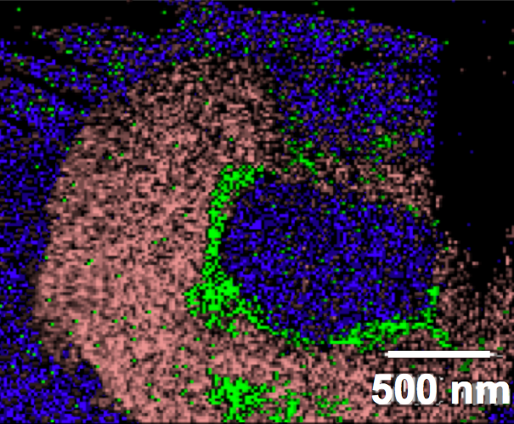
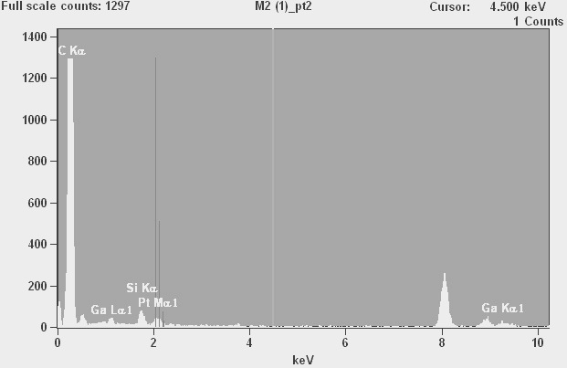
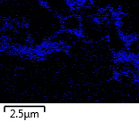
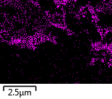
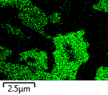
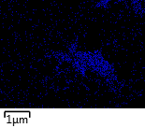
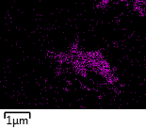
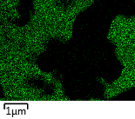
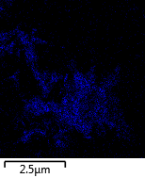
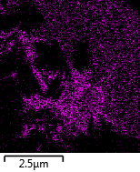
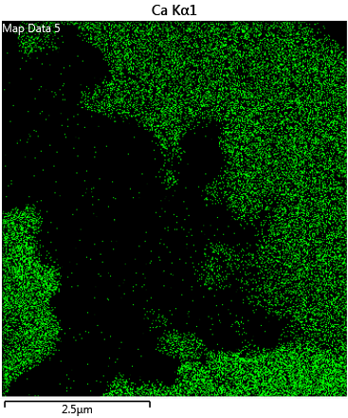
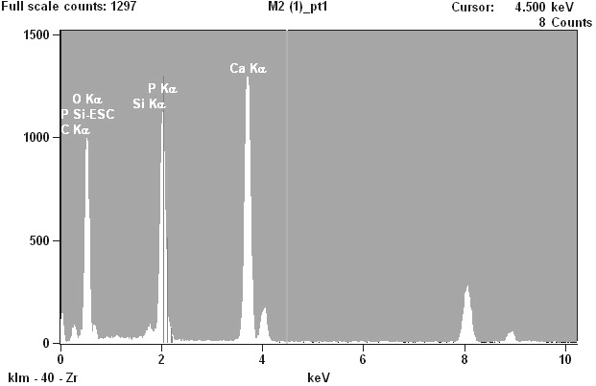
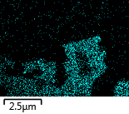
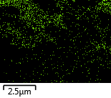
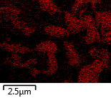
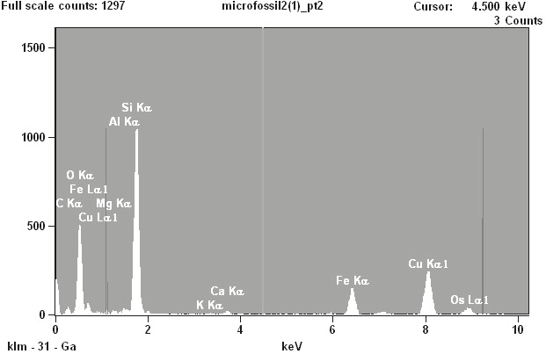
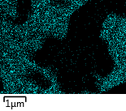
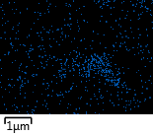
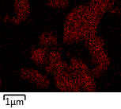
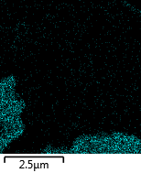
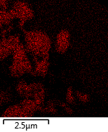
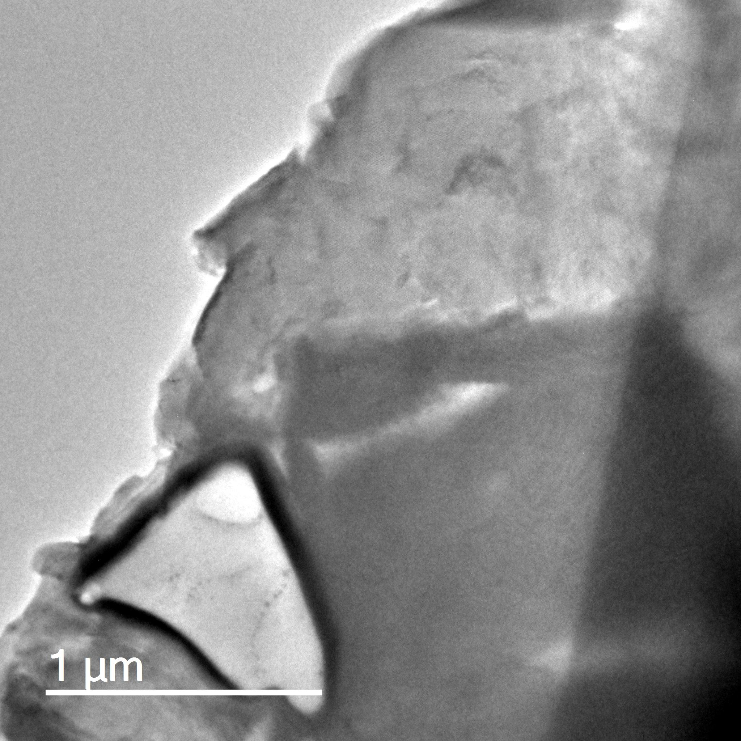
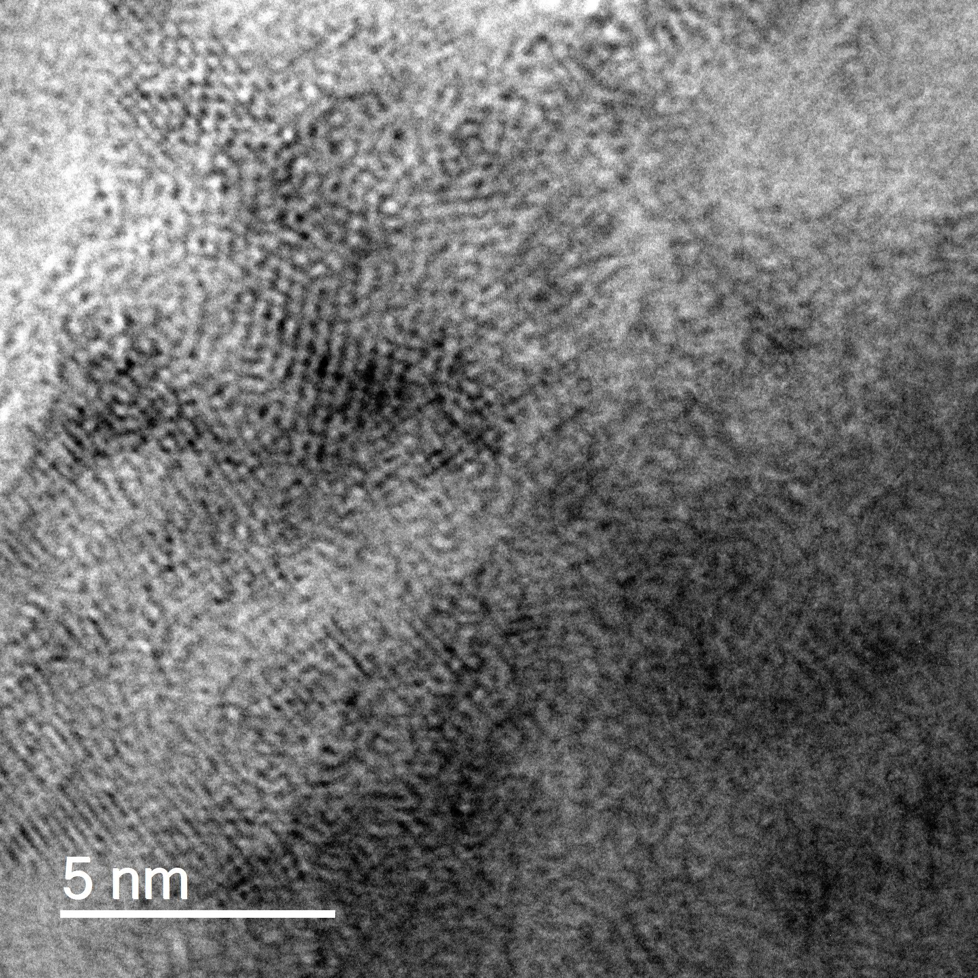
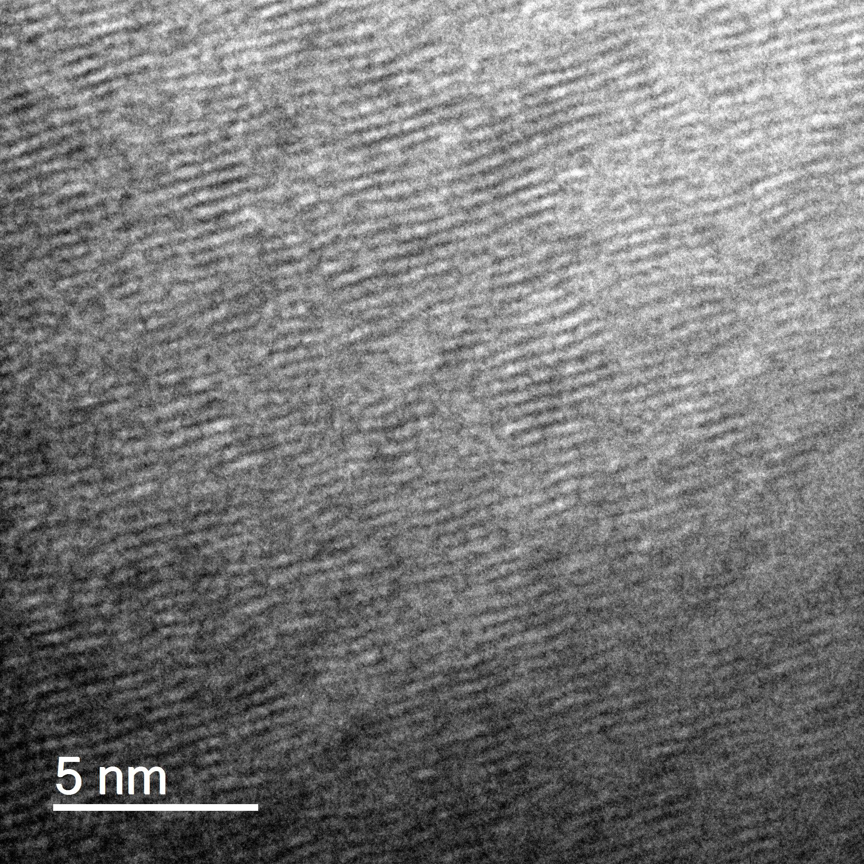
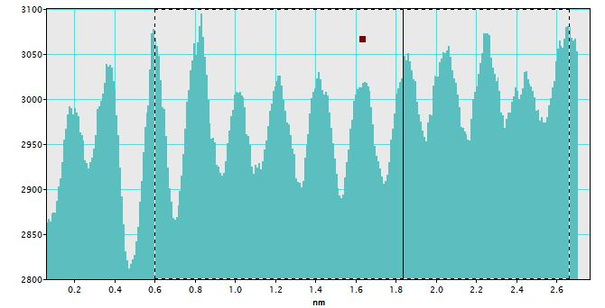
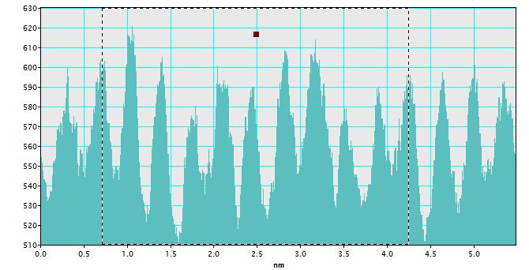
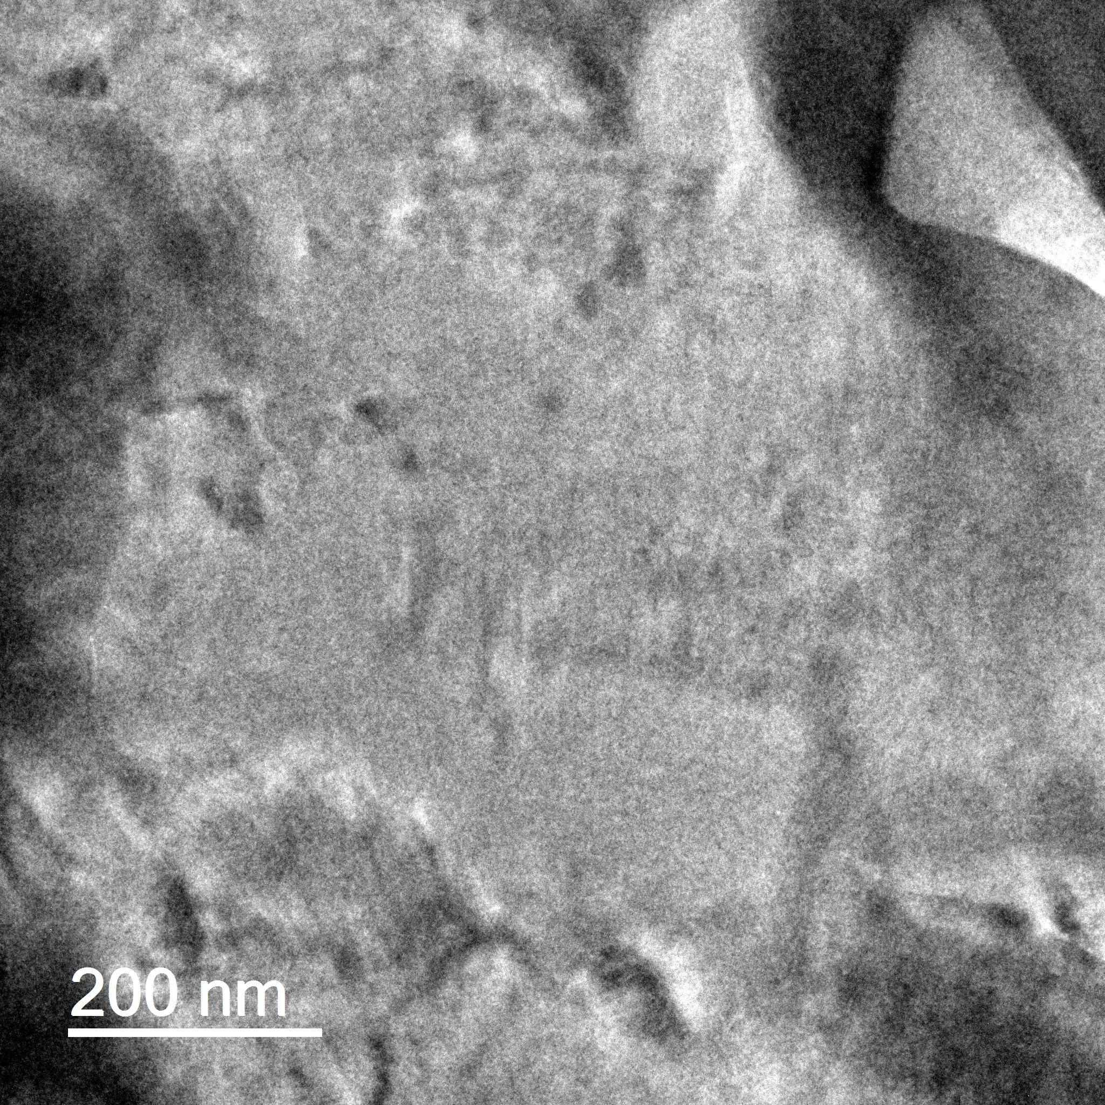
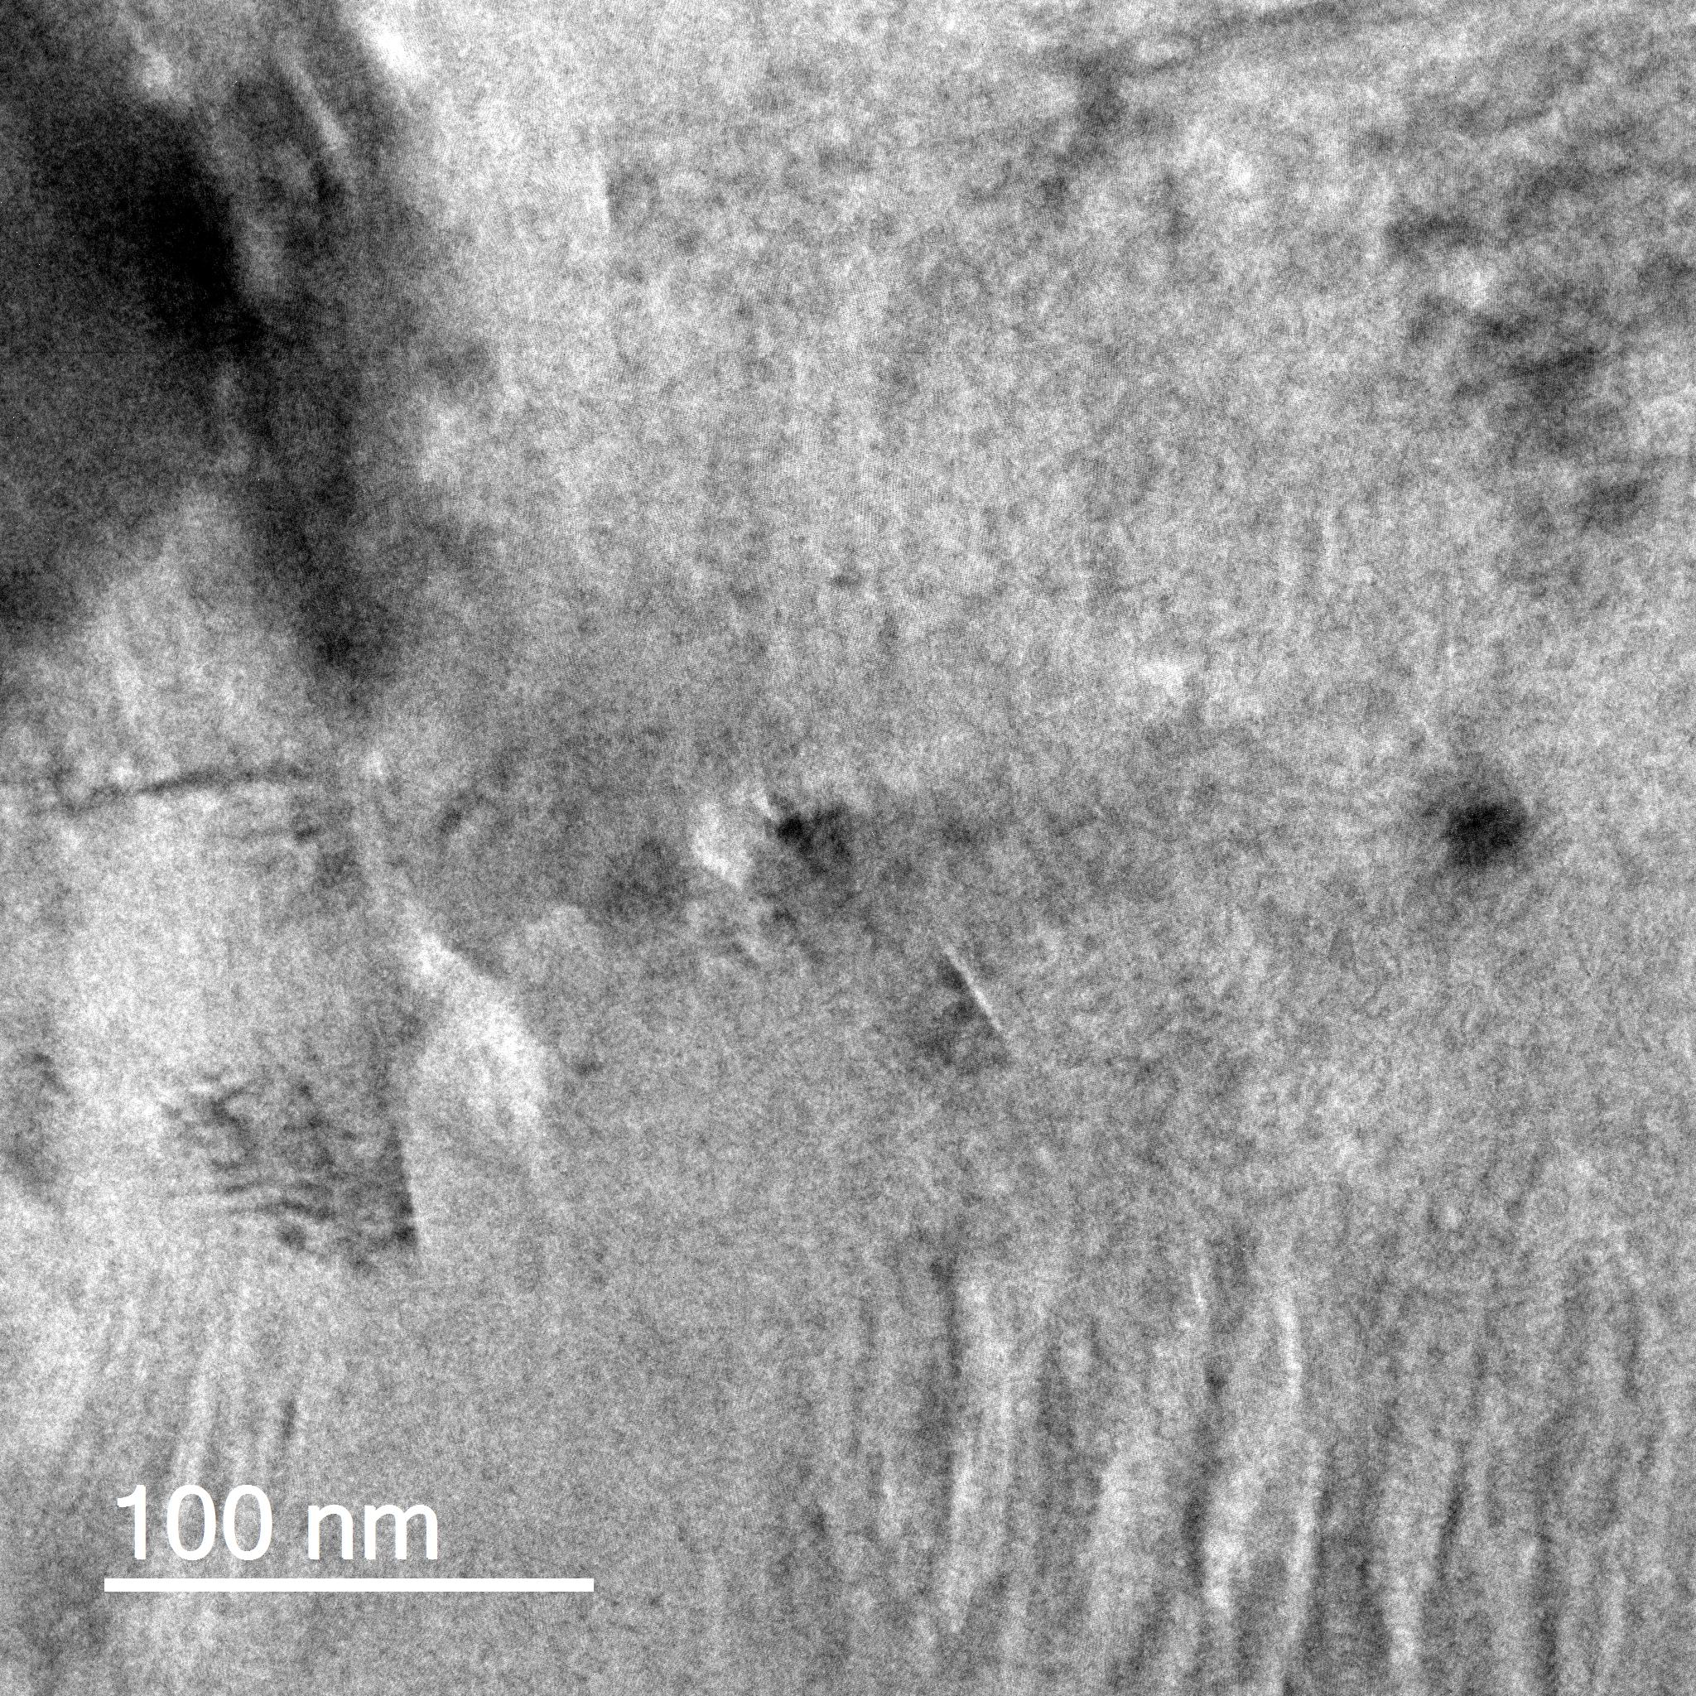
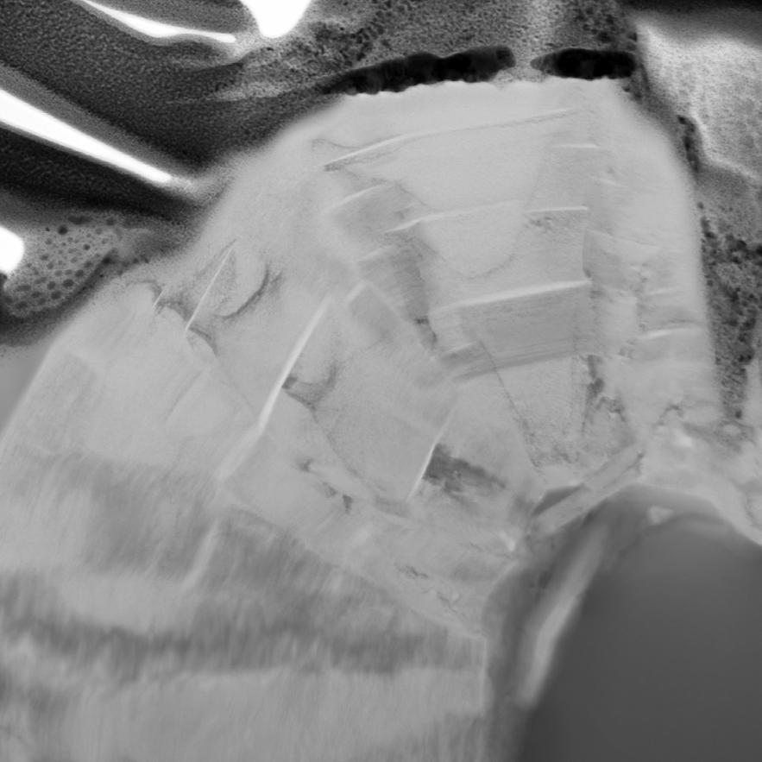
Figure S2 – Papineau et al. (2018)
a)
b)
c) P Fe C
1
2
3
d) Pt Ga
1 μm
e)
Ga Kα
Ca Kα
Cu Kα
C Kα
Fe Kα
Si Kα
f)
P Kα
O Kα
Si
Fe
P
Ca
P
Fe
1-graphite
C
Mg
2-apatite
P
Mg
C
Al
3-sttilpnomelane
Energy (eV)
j)
g)
BF-TEM
h)
HR-TEM
i)
HR-TEM
1
h)
1
i)
HR-TEM
j)
0.2
0.4
0.6
0.8
1.0
1.2
1.4
1.6
1.8
2.0
2.2
2.4
1
d-spacing of graphite
(3.55 Å)
3
2
3
0.5
1.0
1.5
2.0
2.5
3.0
3.5
4.0
4.5
d-spacing of phyllosilicate
(2.08 Å)
d-spacing of graphite
(3.68 Å)
3
1 μm
0.5
1.0
1.5
2.0
2.5
3.0
3.5
4.0
k)
l)
m)
n)
distance (nm)
o)
1 μm
Figure S2: Compositional and structural analysis of graphite and associated minerals. (a-b) Bright-field TEM images of a rounded filament, (c-d) TEM-EDS images of selected elements with spot analyses shown in (e) which shows EDS spectra for graphitic carbon, apatite, and phyllosilicate. (f) Image mosaics of selected elements mapped by TEM-EDS using K_{α} x-ray line intensities selected for Si, Fe, Ca, P, Mg, and C, (g) location of graphite and phyllosilicate with d-spacings measured from fringe in high-resolution TEM images (h-i). (j) Line profiles used to measure d-spacings where profile 2 is from Figure 4f. (k-l) BF images showing nanoscale images of the inclusion-less graphite with some disordered sub-domains (white arrows), and (m-o) visually-correlated images of graphitic carbon without inclusions.
STEM-BF

Slide 4
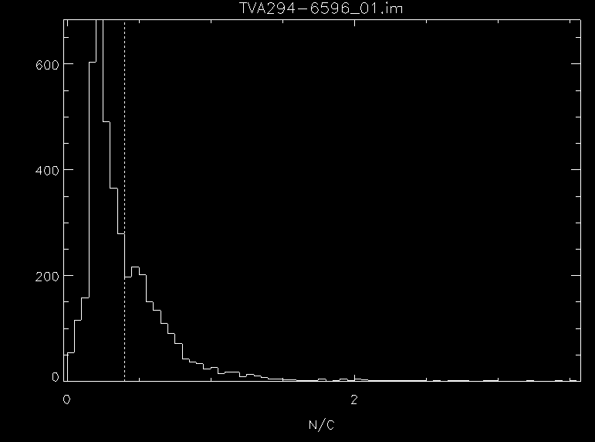
Figure S3 – Papineau et al. (2018)
¹⁶O/¹²C
a)
b)
Intensity (counts)
Intensity (pixel counts)
¹²C¹H
Approximate STXM linescan position (μm)
c)
¹²C¹⁴N⁻/¹²C⁻ (secondary ion ratio)
Figure S3: Additional contextual NanoSIMS images and data. (a) Map of the secondary ion ¹⁶O⁻/¹²C⁻ ratio, binned to display the edges effect of O-bearing phases in direct contact with graphite, which prevented reliable calibration of this map. (b) NanoSIMS secondary ion counts for ¹²C⁻, ¹⁶O⁻, and ¹²C¹⁴N⁻ along the approximate position of the STXM line scan position and used for the calibration of the atomic N/C map using the binning shown in (c).

Slide 5
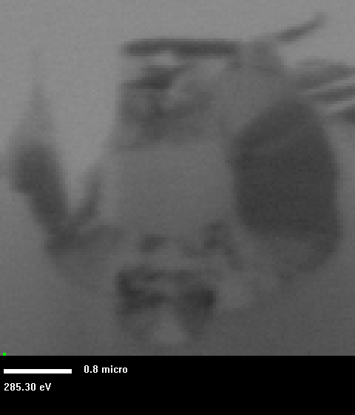
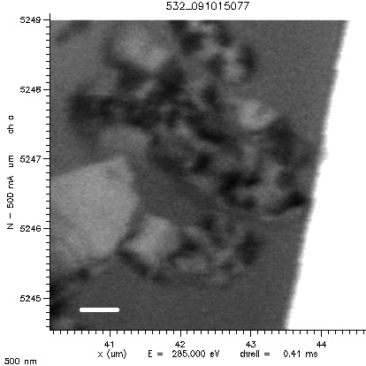
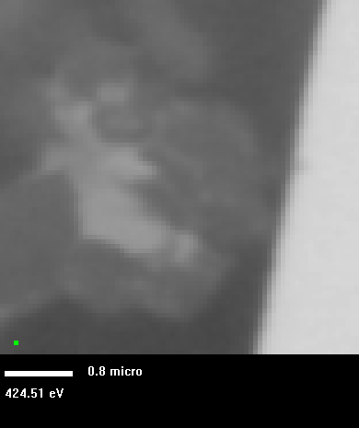
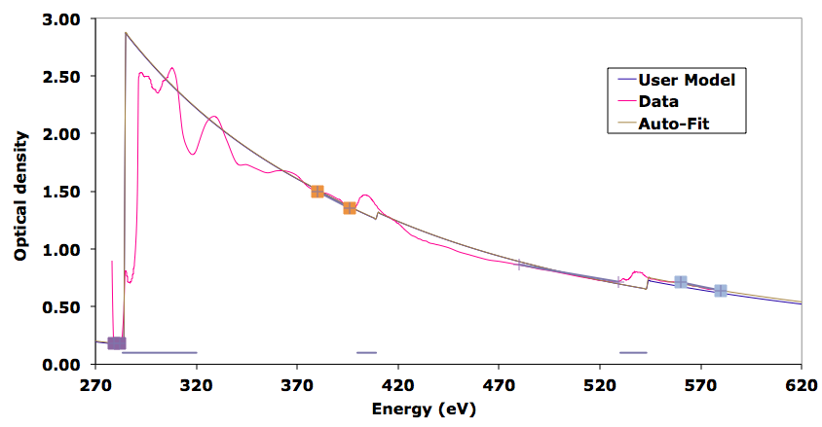
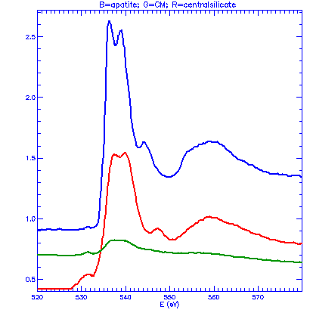
Figure S4 – Papineau et al. (2018)
a)
285.3 eV
b)
285.3 eV
c)
424.5 eV
a)
g)
b)
800 nm
500 nm
800 nm
e)
g)
537.6 eV
538.9 eV
540.1 eV
536.5 eV
544.4 eV
531.7 eV
547.6 eV
N/C = 0.033 ± 0.019
O/C = 0.051 ± 0.021
optical density
f)
apa
distance (μm)
phyl
gra
Energy (eV)
530
540
550
560
570
Energy (eV)
Figure S4: Additional STXM data of the analysed target. (a) A rounded filament of graphitic carbon in apatite at the C-edge. (b) Nanometric domains of a graphitic carbon filament with variable absorption at 285.0 eV and the location of the line scan used for calibration along with (c) the same frame at 424.5 eV showing the ammoniated phyllosilicate. (e-f) Spectrum and line scan shown of the red line shown in (b). (g) O-XANES spectra for apatite, phyllosilicate, and graphitic carbon, all on the same scale, showing the presence of trace O in graphitic carbon.

Slide 6
Figure S5 – Papineau et al. (2018)
20
15
3
10
height (nm)
5
0
50
100
150
200
250
300
distance (nm)
15
2
10
height (nm)
5
0
50
100
150
200
250
300
distance (nm)
6
1
4
height (nm)
2
0
50
100
150
200
250
300
distance (nm)
Figure S5: Selected line profiles from Fig. 8a measured by AFM. These show the near atomic flatness of the nanofabricated graphite and stilpnomelane.

